Slide 1

E SHOPPER
Group members:
LARAIB (2100290140082)
KUSHAGRA TIWARI (2100290140081)
ABHISHEK UPADHYAY (2000290140008)

Slide 2
Introduction
“E-SHOPPER” is process of doing business through computer networks. A person sitting on his chair in front of a computer can access all the facilities of the Internet to buy or sell the products. Unlike traditional commerce that is carried out physically with effort of a person to go & get products, ecommerce has made it easier for human to reduce physical work and to save time. E-Commerce which was started in early 1990’s has taken a great leap in the world of computers, but the fact that has hindered the growth of ecommerce is security. . Security is the challenge facing ecommerce today & there is still a lot of advancement made in the field of security.

Slide 3
Technologies used
HTML
CSS
javaScript
PHP
MYSQL
React

Slide 4
Modules Description
FRONTEND -
Login and Sign up – for logging in or signing up for an account
home page, cart page, shop page, Add to cart, checkout
See previous chats – for viewing your previous chats
BACKEND -
Admin login
order summary, order details stored in Database
Checkout Details

Slide 5
Hardware requirements
Hardware specifications required for installing all the required software environment and tools:
Processor – Intel i3 5th generation or higher
RAM – recommended 4 GB
Disk Space – minimum 10 GB of free disk space

Slide 6
Software requirements
Software environment used for developing the application:
Operating System – Windows 10/11 or Ubuntu 18.04 or above.
Code Editor – Visual Studio Code

Slide 7
benefits
They can respond quickly to market demands.
Even small businesses can increase their sales and grow by selling online.
They can enjoy massive savings in infrastructure, as they need not rent or purchase space in pricey locations or spend on interiors, display, etc.
Sellers can deal in a wide range of products.
Business can be easily scale.

Slide 8
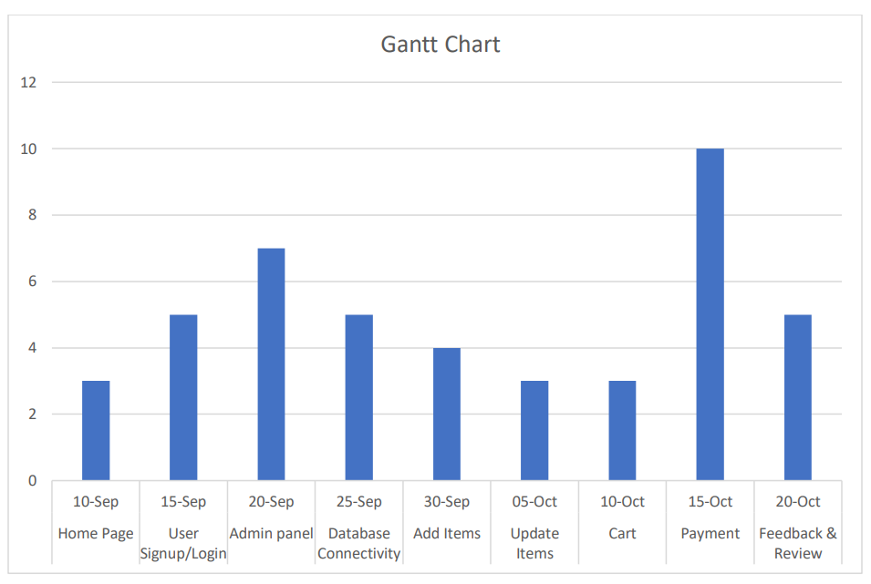
Gantt chart

Slide 9
outcome
A Website providing easy and on time services to the Buyer and making it really efficient to the seller to manage and keep proper records of the orders and transactions made on a daily basis.

Slide 10
Thank you!

